Slide 1
NIH Hour of Code: Python Programming
R. Burke Squires
Bioinformatics and Computational Biosciences Branch (BCBB)
BCBB / OCICB / OSMO / OD / NIAID / NIH

Slide 2
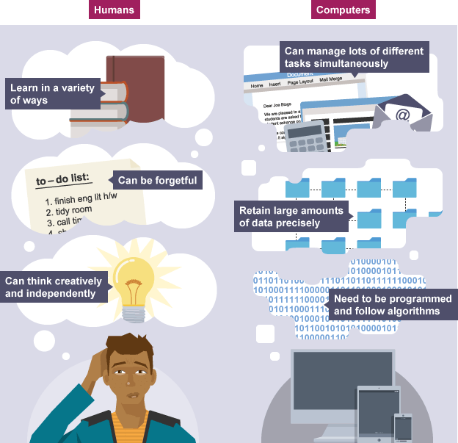
http://www.bbc.co.uk/education/guides/z46s4wx/revision/5

Slide 3
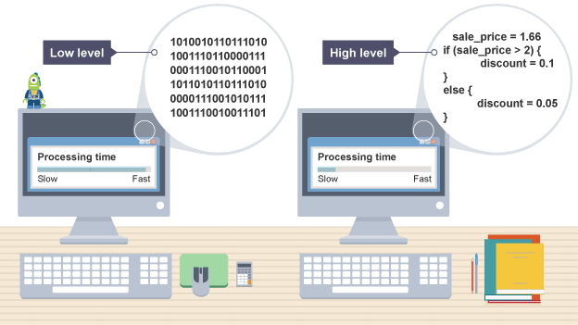
Why Do We Need To Program?
(Not Python Code)
http://www.bbc.co.uk/education/guides/z46s4wx/revision/5

Slide 4
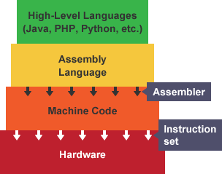
Why Do We Need To Program?

Slide 5
Why Python?

Slide 6
Why Python?
Open source
Easy to learn
Powerful, fast, flexible
“Batteries included”
Large, thriving community
Powerful, mature scientific python stack
Used by many companies
Most popular language for…

Slide 7
Why Python?
Advantages of Python
Specifically
Open source
Easy to learn
Powerful, fast, flexible
“Batteries included”
Large, thriving community
Powerful, mature scientific python stack
Used by many companies
Most popular language for…
Source code is freely downloadable – python.org
You can fix, enhance, contribute
Started in 1991
Guido van Rossum
Borrowed the best parts of many languages
Available on (almost) all platforms – Mac, Windows, linux, raspberry pi, etc

Slide 8
Why Python?
Advantages of Python
Specifically
Open source
Easy to learn
Powerful, fast, flexible
“Batteries included”
Large, thriving community
Powerful, mature scientific python stack
Used by many companies
Most popular language for…
Design philosophy emphasizes code readability
Code is read many more times then it is written!
Indentation is required; enhances readability
Very similar to English language; pseudocode

Slide 9
Printing “Hello World!” in Four Programming Languages
C++
#include <iostream>
int main()
{
std::count << "Hello World” << std::endl;
return 0;
}
Python
print(“Hello World!”)
Java
public class HelloWorld {
public static void main (String[] args) {
System.out.println("Hello World!");
}
}
R
print("Hello World!", quote = FALSE)

Slide 10
Why Python?
Advantages
Specifically
Open source
Easy to learn
Powerful, fast, flexible
“Batteries included”
Large, thriving community
Powerful, mature scientific python stack
Used by many companies
Most popular language for…
Supports multiple programming paradigms:
Object-oriented
Imperative
Functional programming
Procedural styles.
Dynamic type system
Automatic memory management
Can write prototype script very fast
Some packages are written in or enable you to write in C, very fast
Notes:
Dynamic type system – variable type is not known at compile time, flexible

Slide 11
Why Python?
Advantages
Specifically
Open source
Easy to learn
Powerful, fast, flexible
“Batteries included”
Large, thriving community
Powerful, mature scientific python stack
Used by many companies
Most popular language for…
Python has a large and comprehensive standard library
No need to write code yourself
No need to install packages

Slide 12
Why Python?
Advantages
Specifically
Open source
Easy to learn
Powerful, fast, flexible
“Batteries included”
Large, thriving community
Powerful, mature scientific python stack
Used by many companies
Most popular language for…
Python’s standard library
data types
strings
networking
threads
operating
compression
GUI
arguments
system
complex
CGI
FTP
cryptography
numbers
testing
multimedia
databases
CSV
ﬁles
calendar
email
XML
serialization

Slide 13
Why Python?
Advantages
Specifically
Open source
Easy to learn
Powerful, fast, flexible
“Batteries included”
Large, thriving community
Powerful, mature scientific python stack
Used by many companies
Most popular language for…
PyPI – Python Package Index
92,000+ packages 11/2016
Easily installable
Great documentation
Free video training - pyvideo.org
Large support community on stackoverflow, etc
Great conferences: SciPy, PyCon, PyData

Slide 14
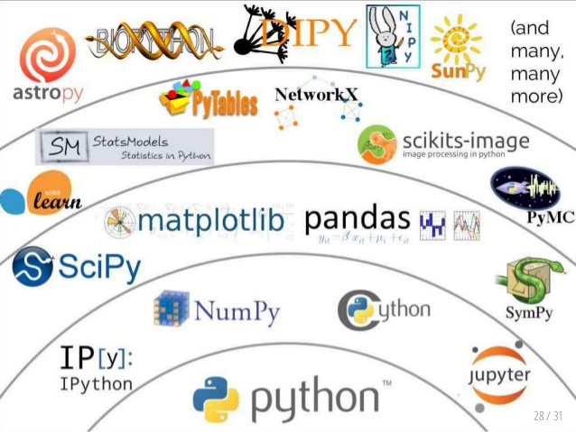
Why Python?
Advantages
Specifically
Open source
Easy to learn
Powerful, fast, flexible
“Batteries included”
Large, thriving community
Powerful, mature scientific python stack
Used by many companies
Most popular language for…

Slide 15
Why Python?
Advantages
Specifically
Open source
Easy to learn
Powerful, fast, flexible
“Batteries included”
Large, thriving community
Powerful, mature scientific python stack
Used by many companies
Most popular language for…
Some of the companies using python
Google (Youtube)
Facebook (Tornado)
Dropbox
Yahoo
NASA
IBM
Mozilla
Quora
Instagram
Reddit
IML (Movies)

Slide 16
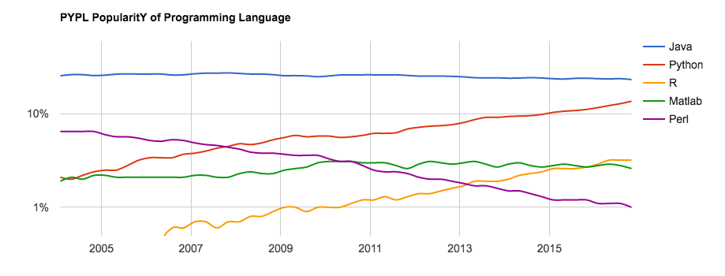
Why Python?
Advantages
Specifically
Open source
Easy to learn
Powerful, fast, flexible
“Batteries included”
Large, thriving community
Powerful, mature scientific python stack
Used by many companies
Most popular language for…

Slide 17
Zen of Python (by Tim Peters)
Beautiful is better than ugly.
Explicit is better than implicit.
Simple is better than complex.
Complex is better than complicated.
Flat is better than nested.
Sparse is better than dense.
Readability counts.
Special cases aren't special enough to break the rules.
Although practicality beats purity.
Errors should never pass silently.
Unless explicitly silenced.
In the face of ambiguity, refuse the temptation to guess.
There should be one--and preferably only one--obvious way to do it.
Although that way may not be obvious at first unless you're Dutch.
Now is better than never.
Although never is often better than *right* now.
If the implementation is hard to explain, it's a bad idea.
If the implementation is easy to explain, it may be a good idea.
Namespaces are one honking great idea -- let's do more of those!

Slide 18
What Can You Do With Python?
Quickly create (prototype) applications
Bioinformatics workflows
Image analysis
Web scrapers
Web Applications ( Django, Pylons )
Games ( Eve Online – MMORPG, pygame )
Software Development ( Trac for Project Management )
Object Databases ( ZODB / Durus )
Network Programming ( Bittorent )
Mobile applications
Data science

Slide 19
Let’s Code!

Slide 20
Programming in Python
Open account at PythonAnywhere.org
Create BASH console
Install biopython module
pip3.5 install --user biopython
Go back to Dashboard
Create a new file
Type in code
Run
(Advanced) Update code to save to a file

Slide 21
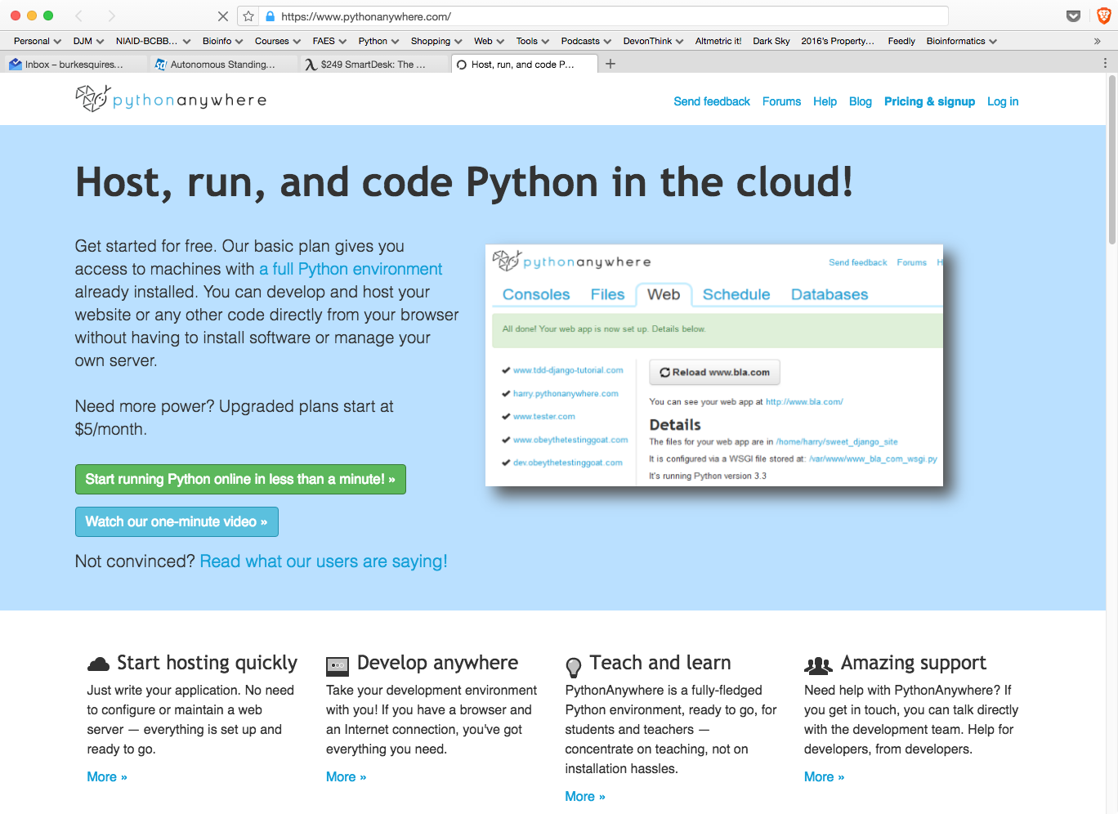
Open Account at PythonAnywhere.org

Slide 22
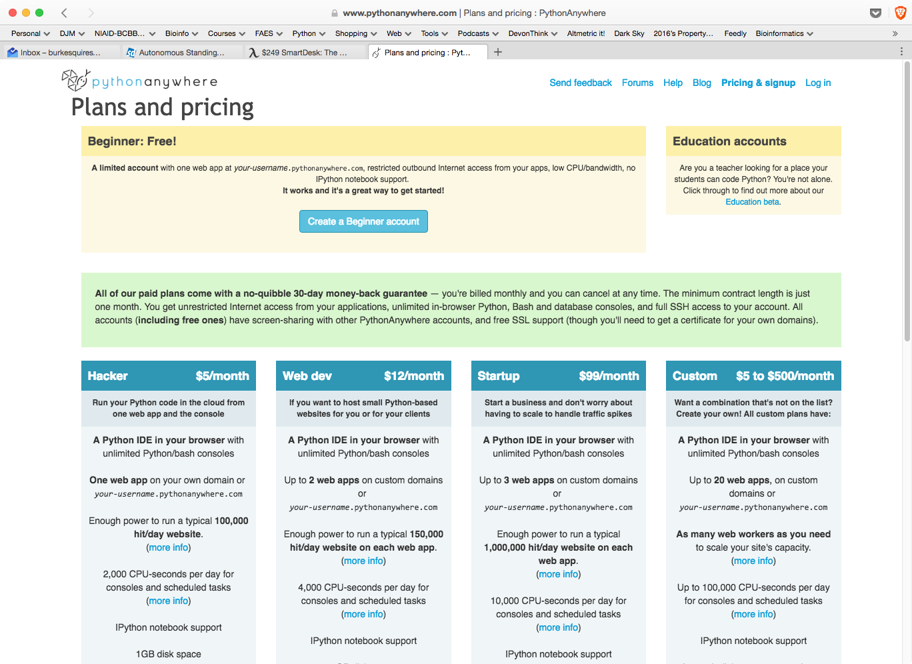
Open Account at PythonAnywhere.org

Slide 23
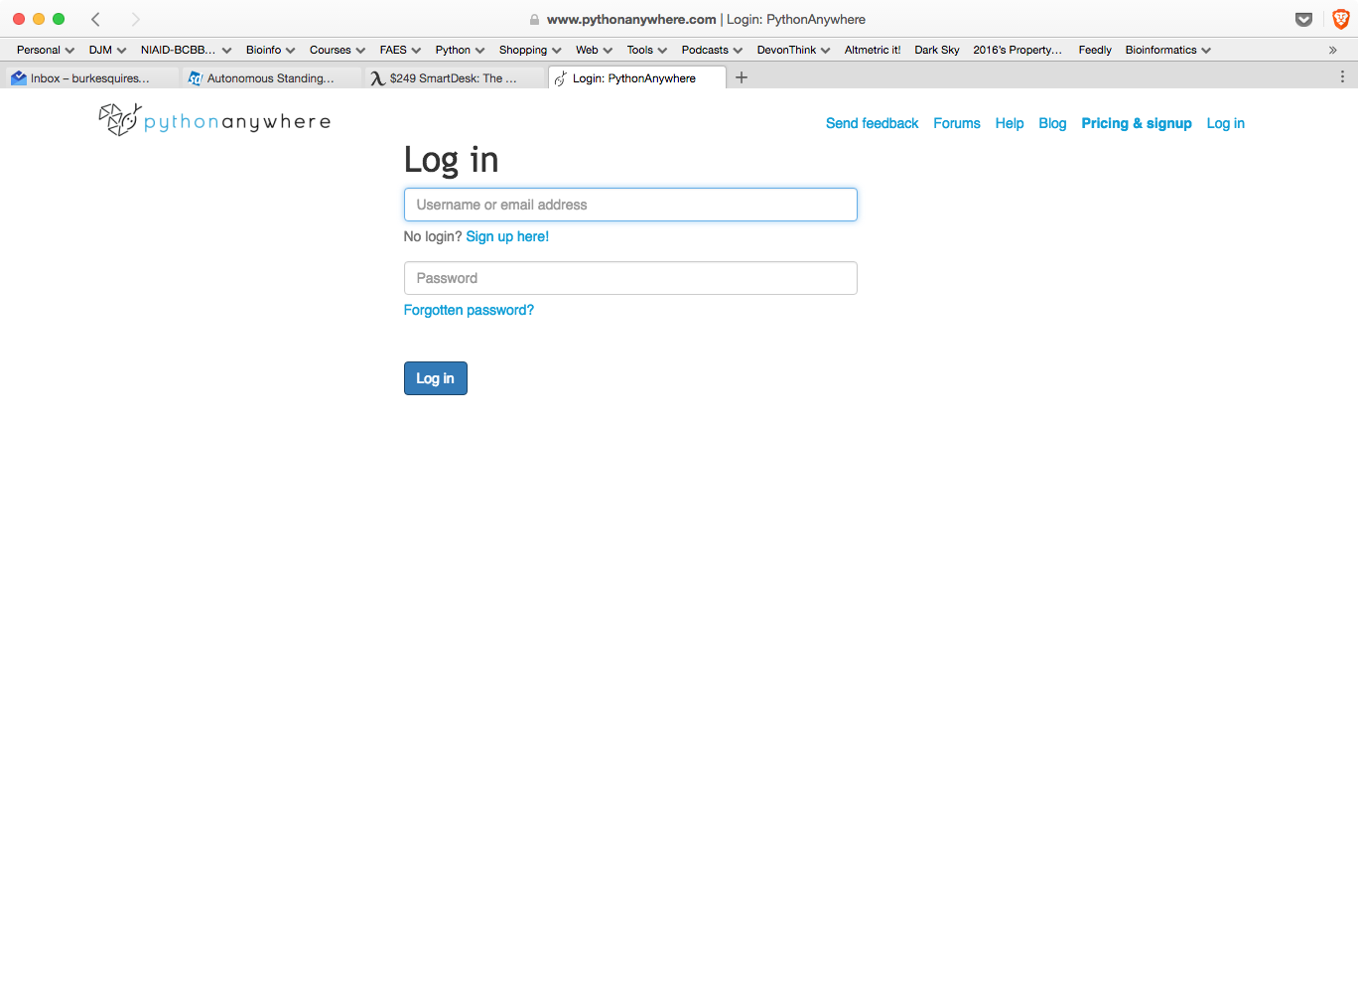
Log into PythonAnywhere.org

Slide 24
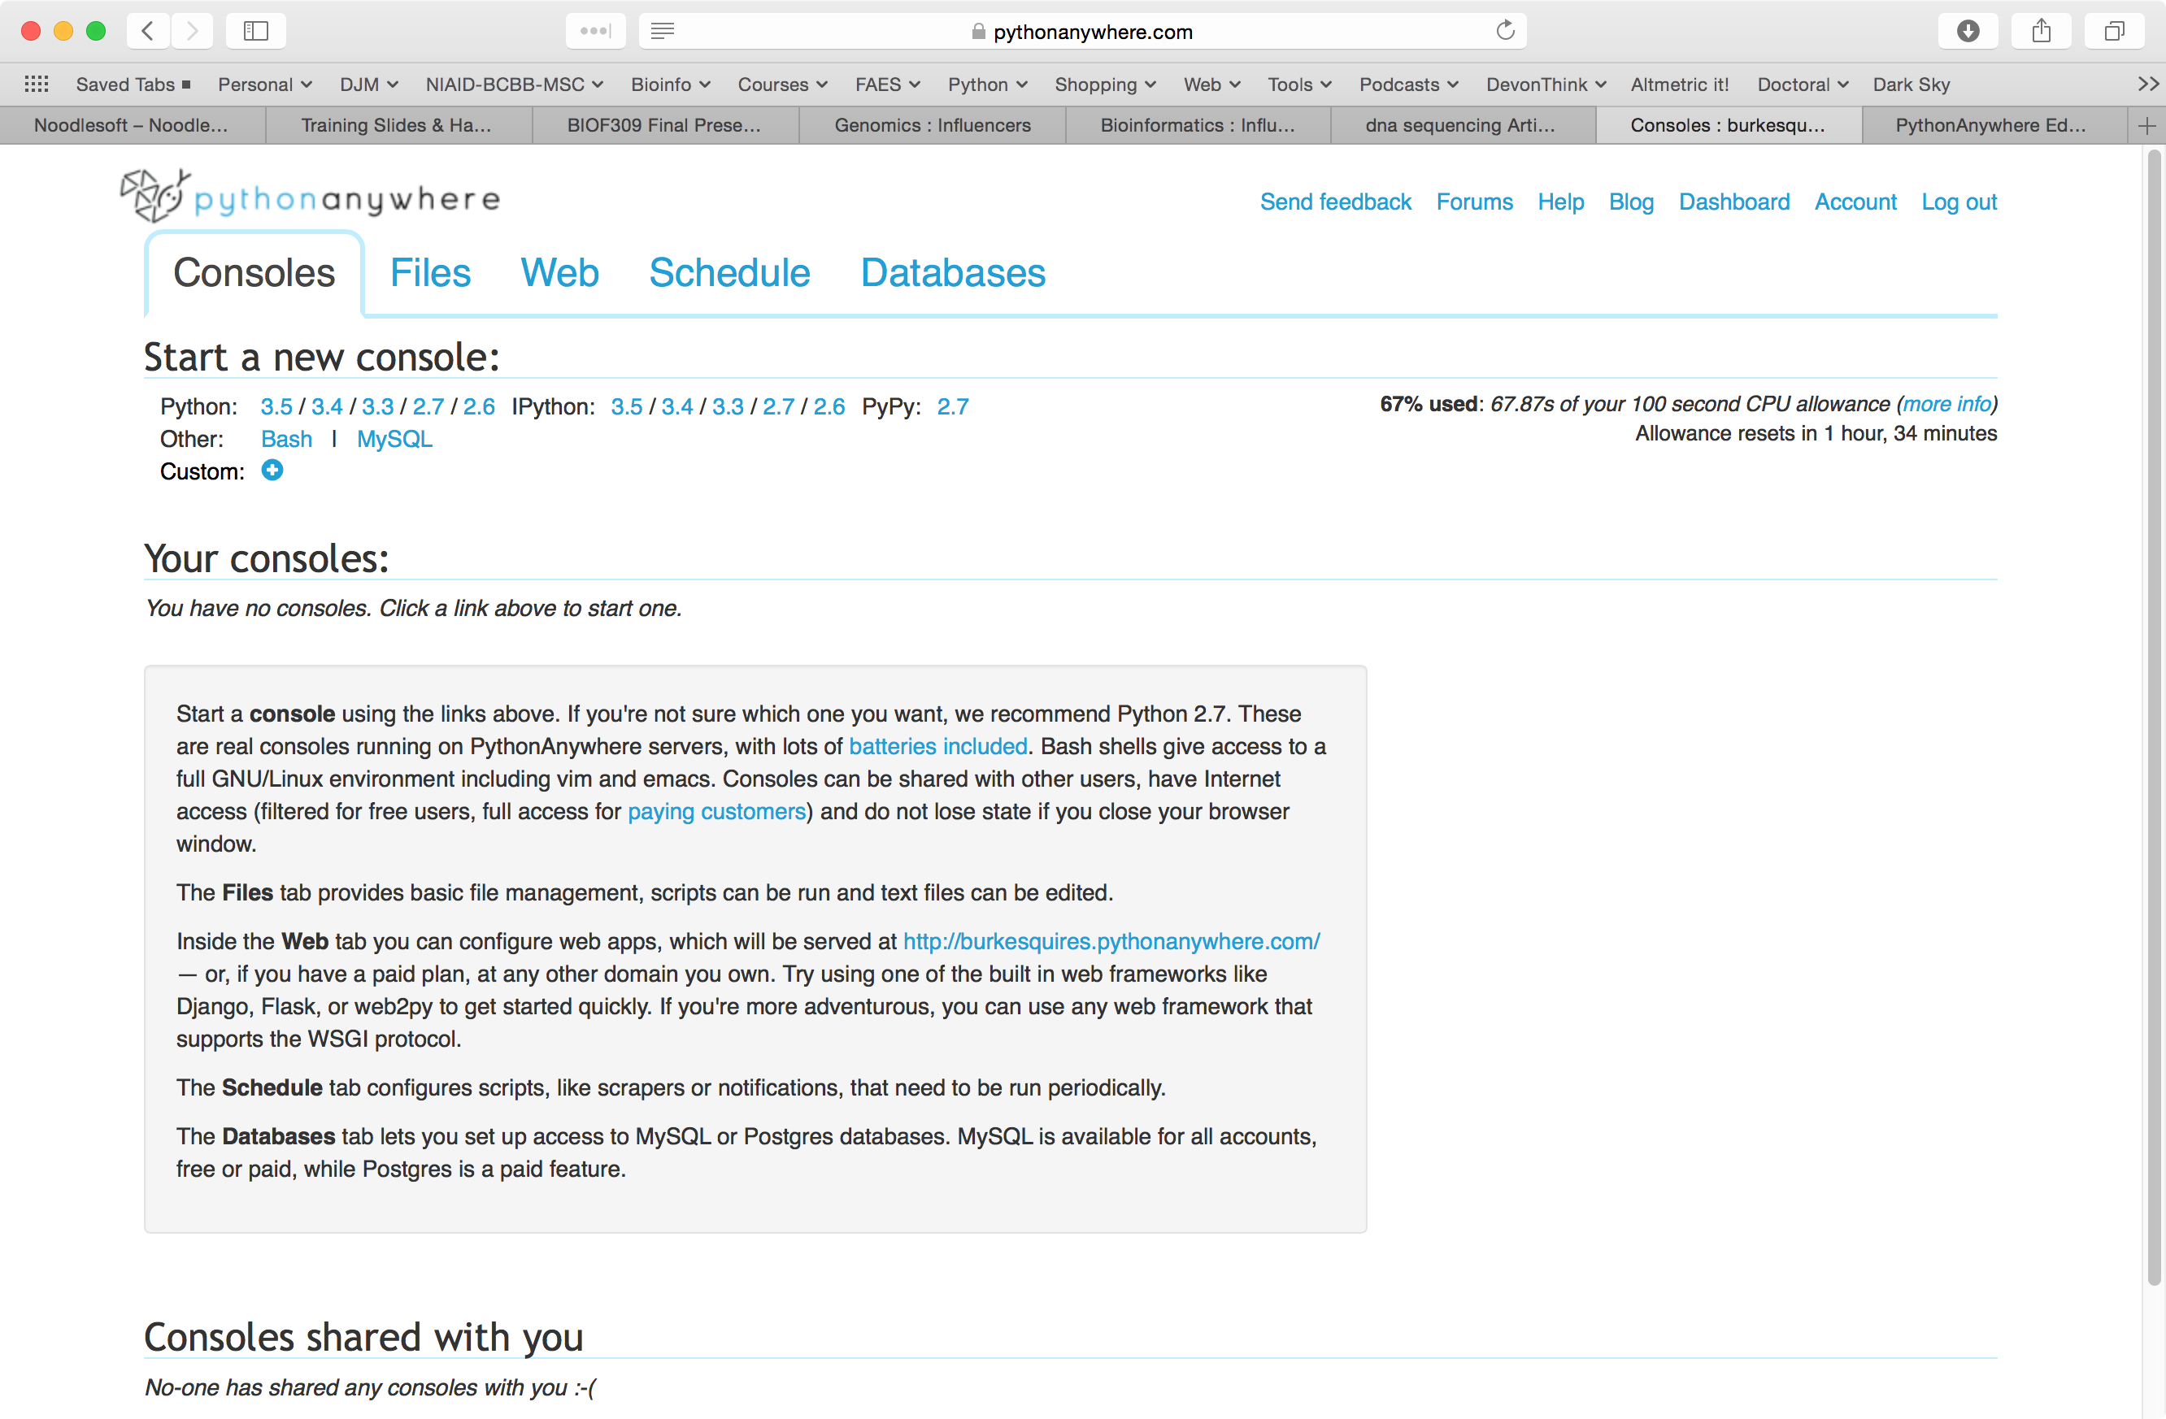
Create BASH Console

Slide 25
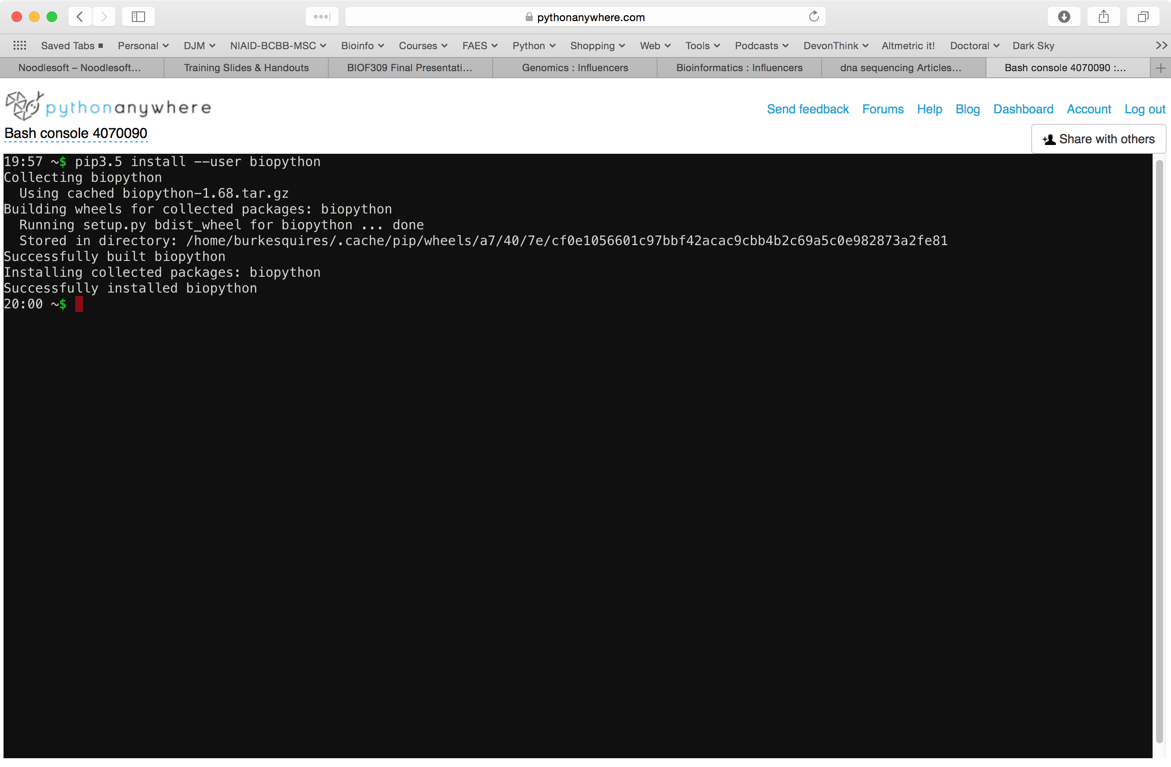
Install Biopython Module: pip3.5 install --user biopython

Slide 26
Go Back to Dashboard

Slide 27
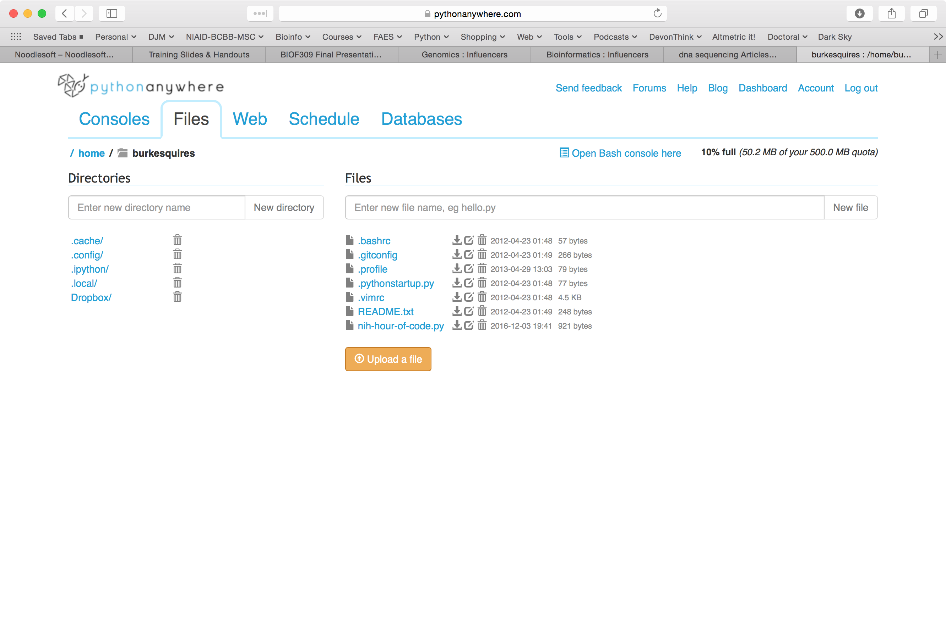
Create a new file

Slide 28
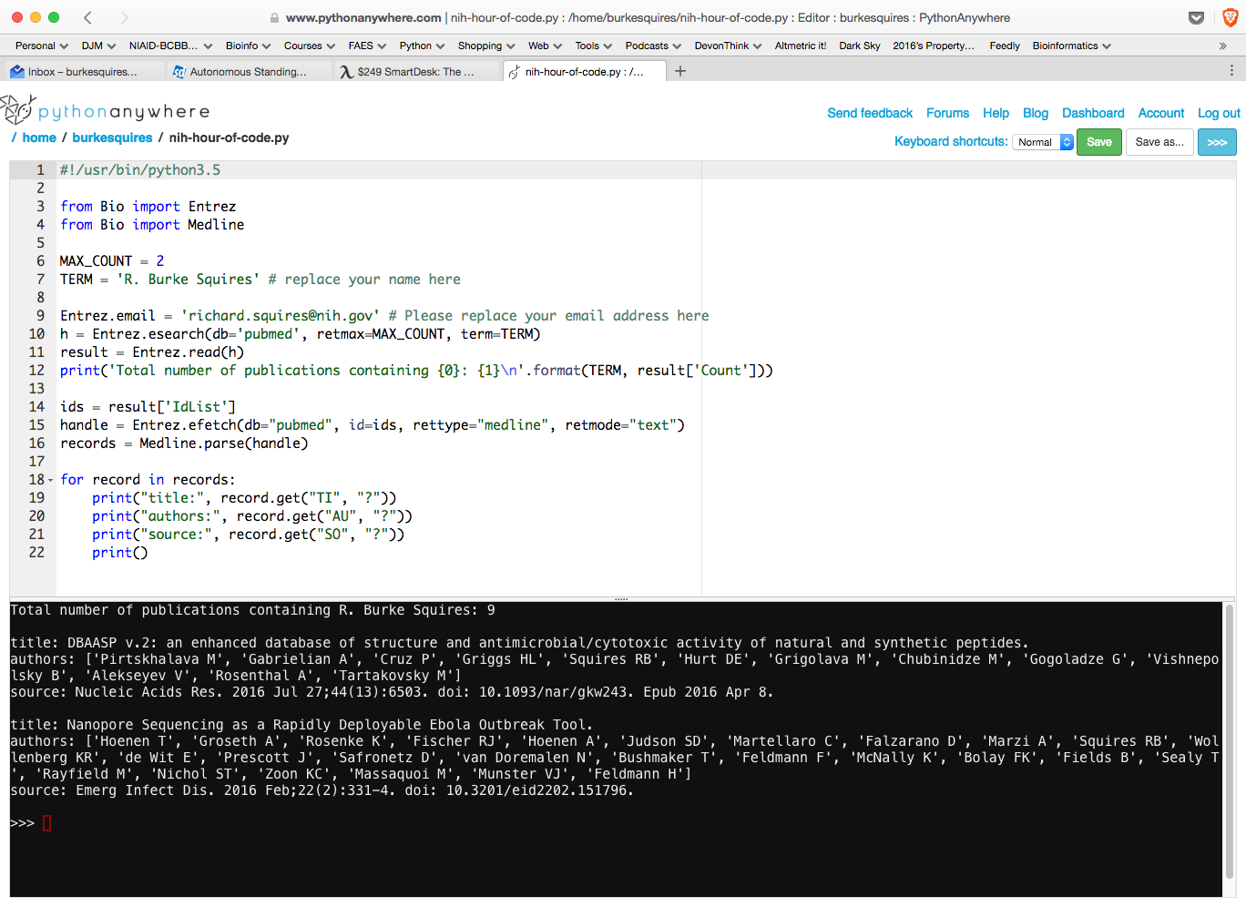
Let’s Write Some Python Code!

Slide 29
Python Code to Retrieve Your Publications
#!/usr/bin/python3.5
from Bio import Entrez
from Bio import Medline
MAX_COUNT = 2
TERM = 'R. Burke Squires' # replace your name here
Entrez.email = 'richard.squires@nih.gov' # Please replace your email address here
h = Entrez.esearch(db='pubmed', retmax=MAX_COUNT, term=TERM)
result = Entrez.read(h)
print('Total number of publications containing {0}: {1}\n'.format(TERM, result['Count']))
ids = result['IdList']
handle = Entrez.efetch(db="pubmed", id=ids, rettype="medline", retmode="text")
records = Medline.parse(handle)
for record in records:
print("title:", record.get("TI", "?"))
print("authors:", record.get("AU", "?"))
print("source:", record.get("SO", "?"))
print()

Slide 30
Run Your Code!

Slide 31

How To Install Python On Your Computer?
Install Python:
Anaconda distribution
Enthought distribution
Installs:
Python
pip
jupyter
numpy
pandas,
etc

Slide 32
Where to Go From Here?
Python Seminars
CIT (No cost)
FAES
Python Programming courses
Tutorials on PyVideo.org
Practice, practice, practice

Slide 33
Resources To Learn More About Python
Free electronic books:
Automate the boring stuff
https://automatetheboringstuff.com
Python for everyone
https://wiki.python.org/moin/IntroductoryBooks
Python books
http://pythonbooks.revolunet.com
Free Python Videos
http://pyvideo.org

